Slide 1
Reinforcement Learning Models for playing Super Mario Bros
Varadh Kaushik, Anirudha Shastri

Slide 2
PRESENTATION OUTLINE
Introducing the topic
Approaches/ algorithms implemented
Comparison of algorithms
Conclusion

Slide 3
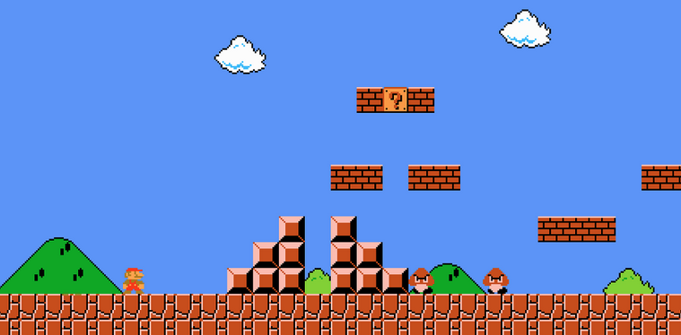
SUPER MARIO BROS
We are using OpenAI Gym environment for Super Mario Bros on The Nintendo Entertainment System (NES) using the nes-py emulator.
The goal of this game is to reach the end of each level while avoiding pitfalls and enemies.

Slide 4
Proximal Policy Optimization [PPO]
Proximal Policy Optimization is a model-free, on-policy, reinforcement learning algorithm
Uses a “policy function” to define a probability distribution over actions
A key feature is its use of “proximal” objective function, which helps stabilize the learning process
Notes:
PPO, or Proximal Policy Optimization, is a reinforcement learning algorithm that is designed to learn an optimal policy in a given environment. It is a type of model-free, on-policy algorithm, which means that it learns directly from the environment without using a pre-specified model, and that it uses the current policy to determine which actions to take.
PPO works by using a set of parameters, called the "policy function," to define a probability distribution over actions. This distribution is used to determine which actions the algorithm should take in a given situation. As the algorithm interacts with the environment, it uses feedback from the environment to update the policy function in order to improve the policy's performance.
One key feature of PPO is its use of a "proximal" objective function, which encourages the algorithm to update its policy in a way that is similar to the current policy. This helps to stabilize the learning process and prevent the algorithm from making too many drastic changes to the policy.
Overall, PPO is a powerful and effective algorithm for learning optimal policies in reinforcement learning environments.
=====

Slide 5
Deep Q Networks [DQNs]
Deep Q Networks are a model-free, reinforcement learning algorithm
They use a neural network to approximate the optimal action-value/Q function
Can handle high-dimensional state spaces, that are found in complex, real-world environments, as they use neural networks
Notes:
Deep Q networks (DQNs) are a type of reinforcement learning algorithm that uses a neural network to approximate the optimal action-value function, or Q-function, for a given environment. The Q-function is a measure of the long-term reward that an agent can expect to receive by taking a particular action in a given state. By approximating the Q-function, DQNs can learn which actions to take in order to maximize this long-term reward.
DQNs are model-free algorithms, which means that they do not require a pre-specified model of the environment in order to learn. Instead, they use experience from interacting with the environment to update their estimates of the Q-function. This is done by using a variant of the Q-learning algorithm, which uses a bellman equation to update the Q-function based on the rewards and transitions observed in the environment.
One key advantage of DQNs is their ability to handle high-dimensional state spaces, such as those that are common in complex, real-world environments. This is because they use a neural network, which is a flexible and powerful function approximator, to represent the Q-function.
Overall, DQNs are a powerful and effective tool for reinforcement learning in complex environments.

Slide 6
Double Deep Q Networks [DDQNs]
Double Deep Q Networks are a variant of DQNs
They use two separate networks, called the “target” and “online” networks
In DQNs use the same network to both select the action of a given state and to evaluate the quality of that action
Here, we use the “online” network to select actions and the “target” network to evaluate the quality of those actions
Notes:
Double deep Q networks (DDQNs) are a variant of deep Q networks (DQNs) that are used in reinforcement learning. Like DQNs, DDQNs use a neural network to approximate the optimal action-value function, or Q-function, for a given environment. However, DDQNs address a key limitation of DQNs by using two separate networks, called the "target" and "online" networks, to address the problem of "overestimation" of action values.
In DQNs, the same network is used to both select the action to take in a given state and to evaluate the quality of that action. This can lead to overestimation of the action values, which can in turn lead to suboptimal behavior. DDQNs address this problem by using two separate networks: the online network is used to select actions, while the target network is used to evaluate the quality of those actions. This helps to reduce overestimation and improve the performance of the algorithm.
Overall, DDQNs are a powerful extension of DQNs that can improve the performance of reinforcement learning algorithms in complex environments.

Slide 7
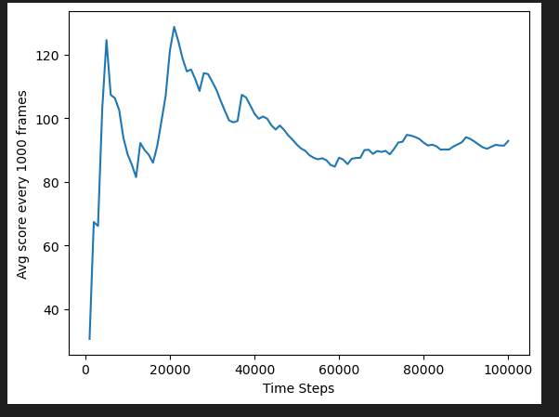
Performance comparison: PPO
Train: 3,000,000 time steps
Learning Rate: 0.000001
Model save intervals: 10,000
Training time: 6 hrs

Slide 8
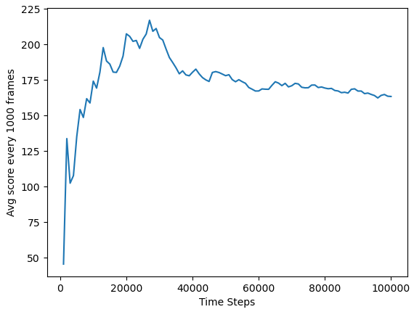
Performance comparison: DQN
Train: 3,000,000 time steps
Learning Rate: 0.000001
Model save intervals: 10,000
Training Time: 6 hrs
1,050,000 time steps model

Slide 9
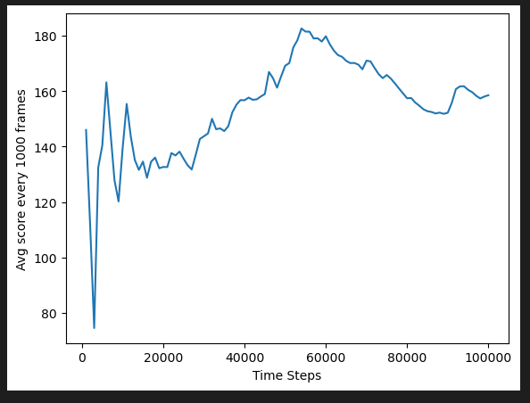
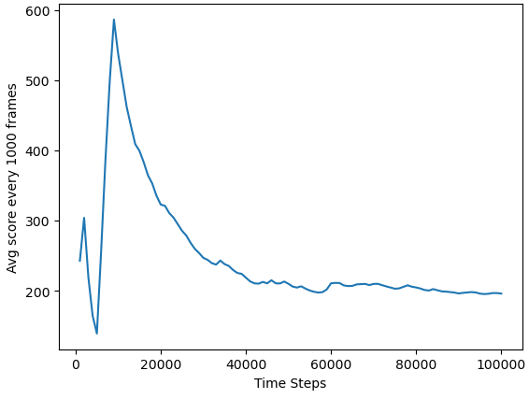
Performance comparison: DQN (Cont)
1,740,000 time steps model
2,560,000 time steps model

Slide 10
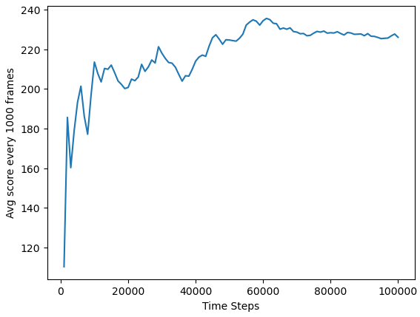
Performance comparison: DDQN
Train: 2000 Episodes
Learning Rate: 0.00025
Batch size:128
Training Time: <3 hrs

Slide 11
POTENTIAL IMPROVEMENTS
Training for longer on better hardware
More complicated CNN models for (D/)DQNs
Other Reinforcement algorithms: Alpha GO Zero

Slide 12
CONCLUSION
PPO: Needs to lots of training and will have lower performance than DQN and DDQN for same amount of training.
DQN: In game it extracts more features like collecting coins as well. Slightly better performance than PPO.
DDQN : Performs extremely well for little training. It is able extract more details and have a higher score in the same traversed distance.

Slide 13
REFERENCES
Firoiu, Vlad, William F. Whitney, and Joshua B. Tenenbaum. "Beating the world's best at Super Smash Bros. with deep reinforcement learning." arXiv preprint arXiv:1702.06230 (2017).
Schulman, John, et al. "Proximal policy optimization algorithms." arXiv preprint arXiv:1707.06347 (2017).

